Slide 1
Developing Push Datasets and Real-time Dashboards
Notes:
This module teaches students how to create push datasets and to build real-time dashboards in Power BI. The module examines differences between streaming datasets, push datasets and hybrid datasets and explains how to choose between them for a specific scenario. Students will learn how to use the Power BI Service API to create streaming datasets and to push in rows of data in real time from across the Internet. Students will also learn how to build a real-time dashboards on top of a streaming dataset using streaming data tiles. The module demonstrates how create push datasets with multiple tables and measures containing DAX expressions. The module concludes with an examination of creating push datasets and explores the extra design features they make available that are not supported in streaming datasets or hybrid datasets.

Slide 2
Agenda
Introduction to Real-time Datasets
Creating a Streaming Dataset with the API
Designing Dashboards with Streaming Data Tiles
Creating a Push Dataset with Real-time Data

Slide 3
Pull Datasets versus Real-time Datasets
Pull Datasets
Imported Datasets
DirectQuery Datasets
Live Connect Datasets
Real-time Datasets
Streaming Datasets
Push Datasets
Hybrid Datasets
Pull
Power BI
Service
Custom
Application
Power BI
Service API
Push
Power BI
Service

Slide 4
Streaming Datasets
Data stored in cloud-based cache – not persisted in DB
Restricted to single table - no rich data modeling
Not supported by standard Power BI report designer
Dashboard created using specialized streaming data tiles
No support for DAX, aggregation or filtering
Streaming Data Tiles

Slide 5
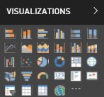
Push Datasets
Data stored in Azure SQL DB – not in cache
Supports multiple tables and table relationships
Supported by standard Power BI report designer
Supports DAX, measures, aggregation & filtering

Slide 6
Hybrid Datasets
Data stored in cloud-based cache AND in Azure SQL DB
Restricted to single table and no rich data modeling
Supported by streaming data tiles
Supported by Power BI report designer
Real-time Tiles

Slide 7
Agenda
Introduction to Real-time Datasets
Creating a Streaming Dataset with the API
Designing Dashboards with Streaming Data Tiles
Creating a Push Dataset with Real-time Data

Slide 8


Real-time Scenario Being Simulated
Heisenberg labs processes chemicals
Required to monitor temperatures during processing
Temperature must be monitored on per-second basis
Send alerts if temperature exceeds preset threshold

Slide 9
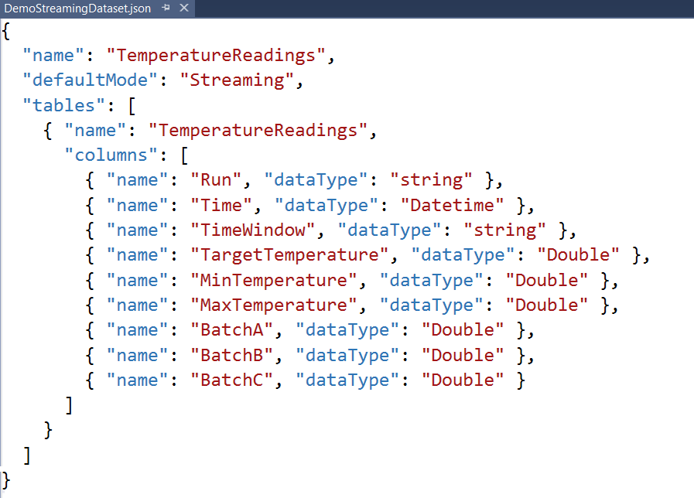
Creating a Streaming Dataset
Streaming dataset created using JSON schema definition
Streaming dataset limited to a single table
Columns defined using name and datatype
No support for any other column properties (e.g. formatting)

Slide 10
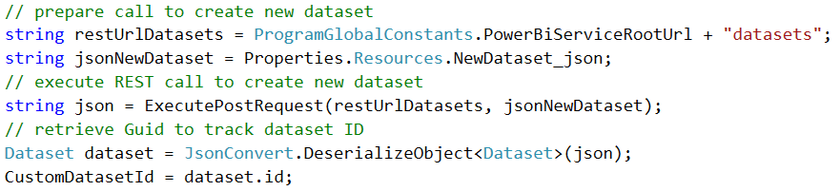
Creating a Custom Dataset
Dataset created by executing HTTP POST operation
One-time operation done as application begins running
1
2
3
Power BI Service
HTTP POST
My Streaming Dataset
Access Token
JSON
TemperatureReadings table

Slide 11
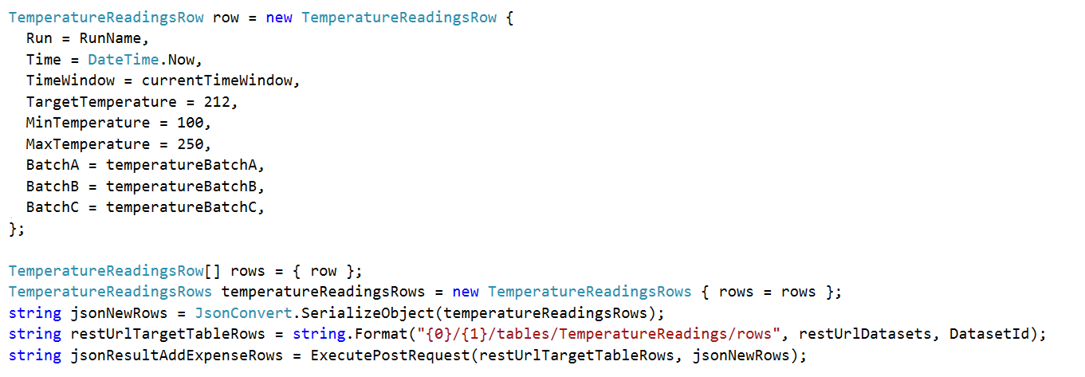
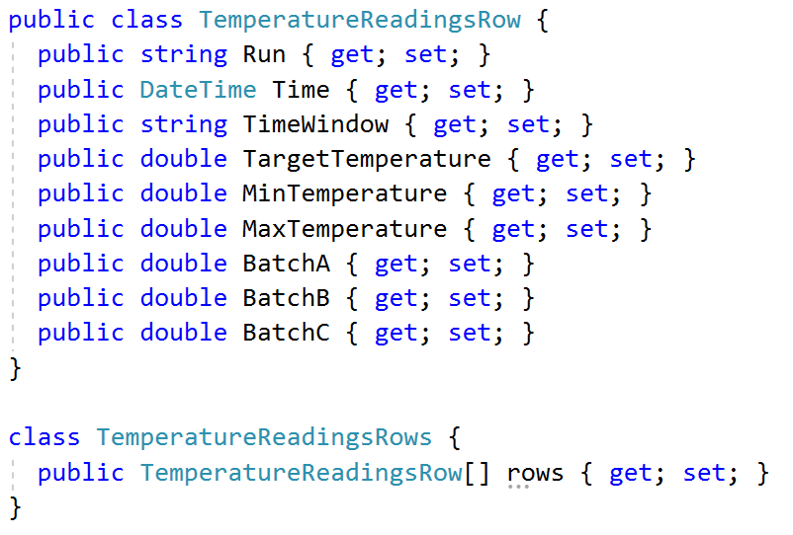
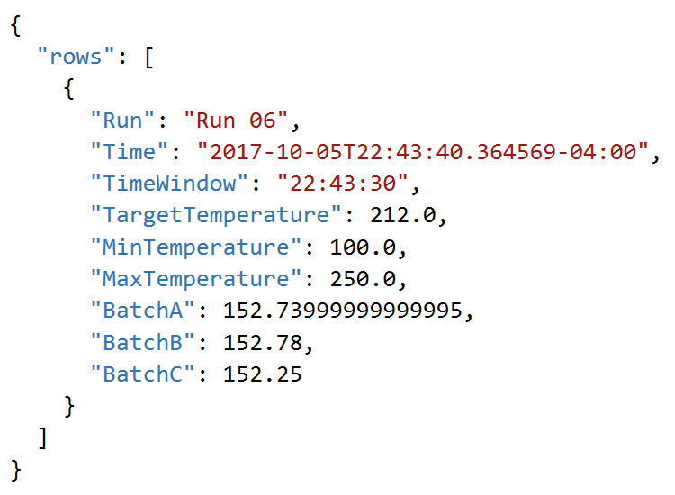
Adding Rows by Converting C# to JSON

Slide 12
Creating a Streaming Dataset using the Power BI Service API

Slide 13
Agenda
Introduction to Real-time Datasets
Creating a Streaming Dataset with the API
Designing Dashboards with Streaming Data Tiles
Creating a Push Dataset with Real-time Data
Integrating Azure Streaming Analytics Jobs

Slide 14
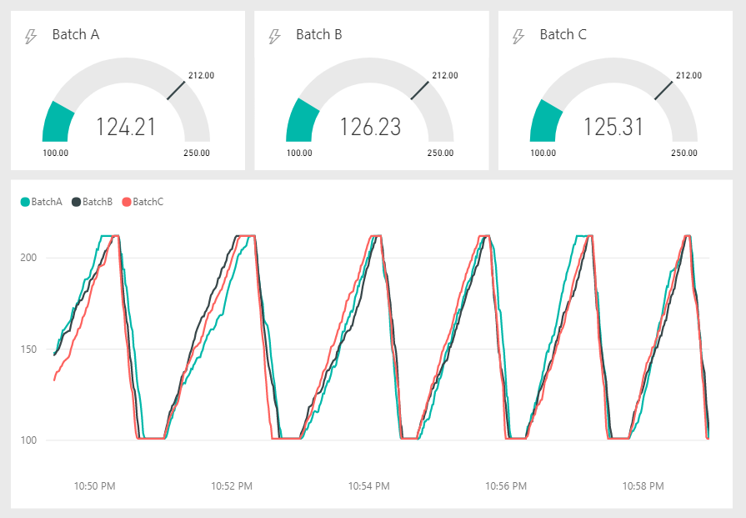
Streaming Data Tiles
Streaming Data surfaced using Streaming Data Tiles
Used to surface data values from streaming dataset cache
Optimized to provide smooth animations for real-time data
Available set of streaming titles as of today
Card
Gauge
Line chart
Cluster Bar Chart
Cluster Column Chart

Slide 15
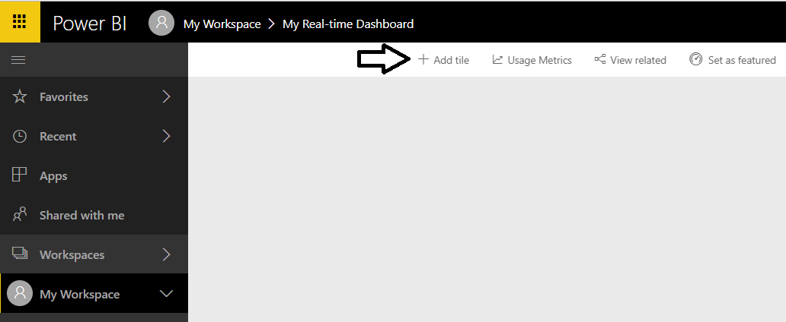
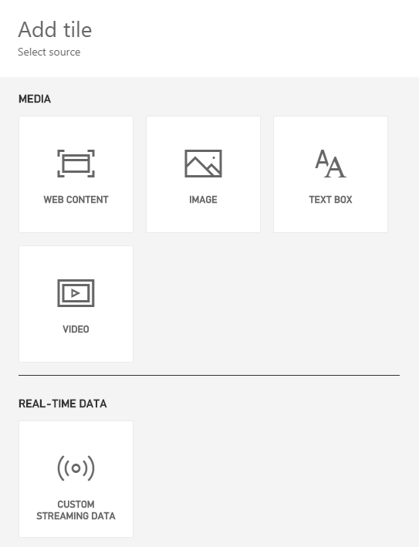
Creating Dashboards with Streaming Datasets
You cannot use the Power BI report designer
Instead, you add real-time data tiles directly to a dashboard
Real-time data tiles different from standard set of Power BI visuals

Slide 16
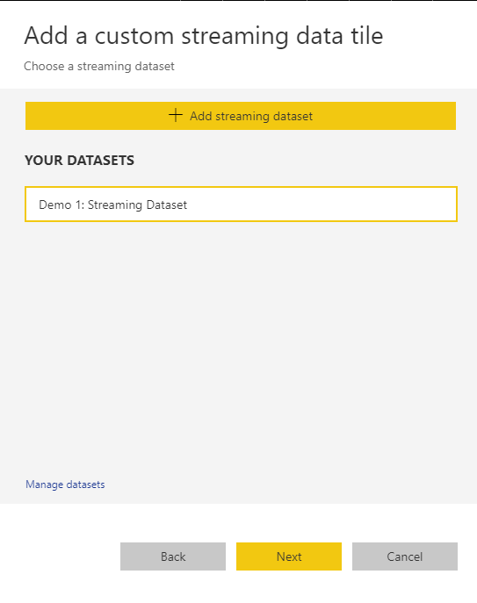
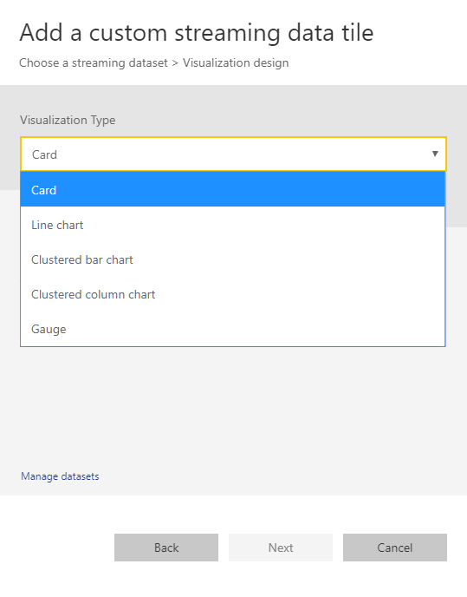
Creating a New Streaming Data Tile
When creating a streaming data tile…
Select dataset that is a streaming dataset or a hybrid dataset
Choose the type of data streaming tile

Slide 17
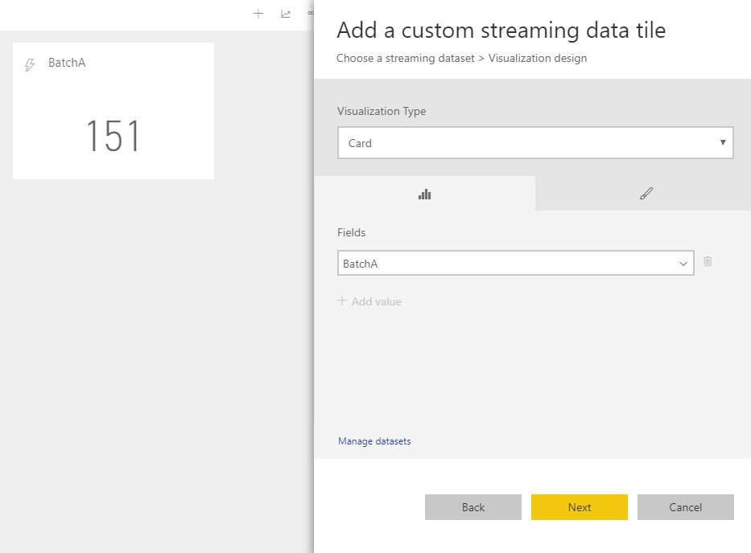
Real-time Data Tile Field Pane

Slide 18
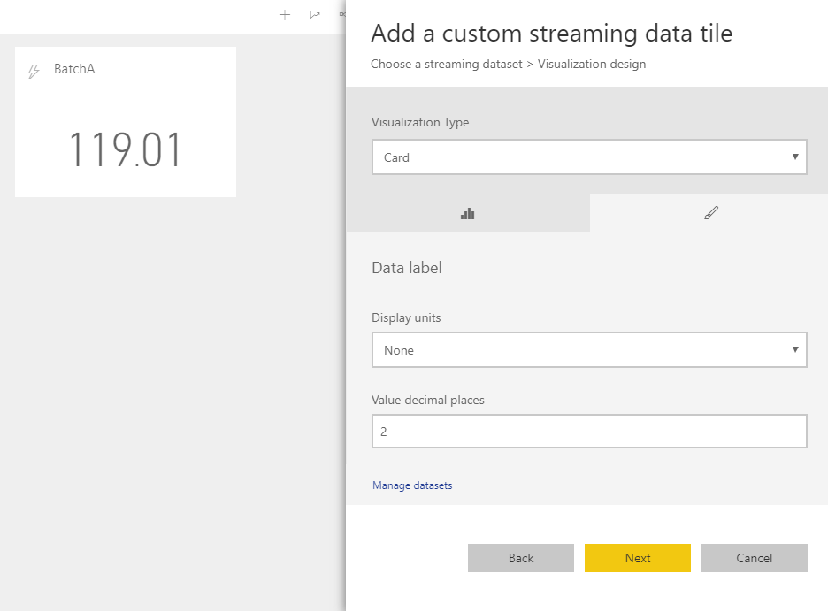
Real-time Data Tile Format Pane

Slide 19
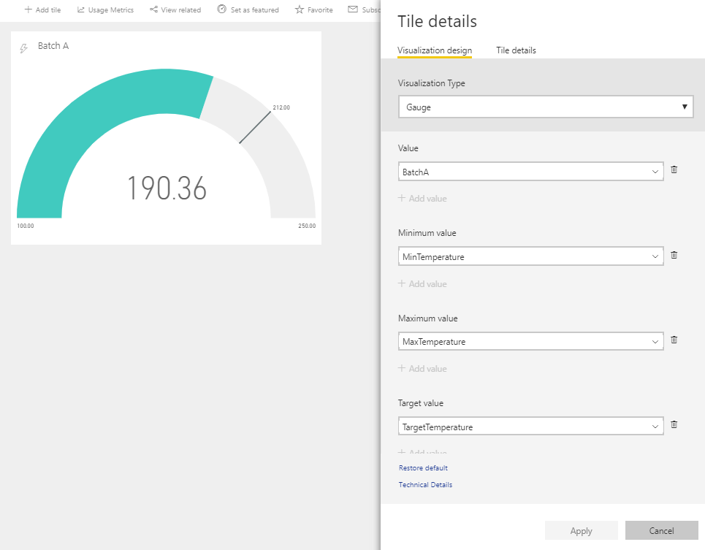
Streaming Gauge Tile

Slide 20
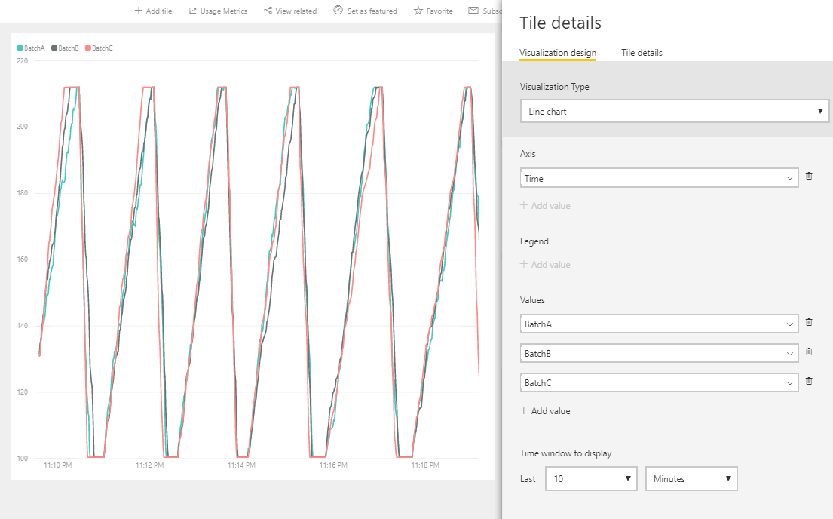
Streaming Line Chart Tile

Slide 21
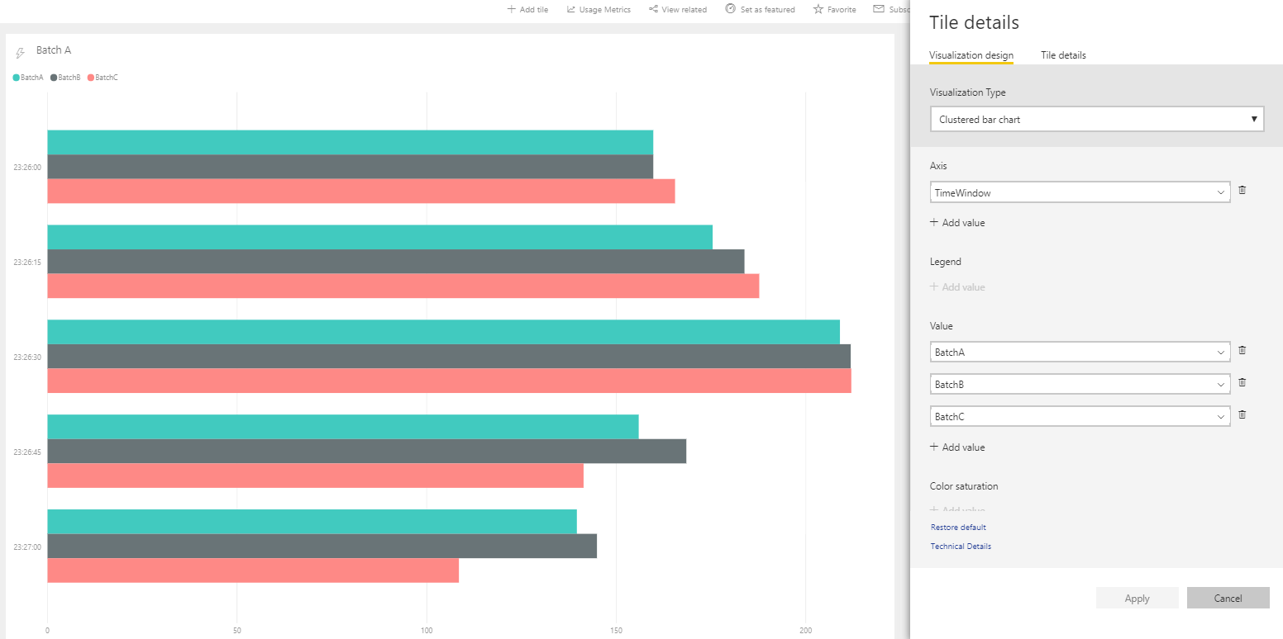
Streaming Clustered Bar Chart Tile

Slide 22
Agenda
Introduction to Real-time Datasets
Creating a Streaming Dataset with the API
Designing Dashboards with Streaming Data Tiles
Creating a Push Dataset with Real-time Data

Slide 23
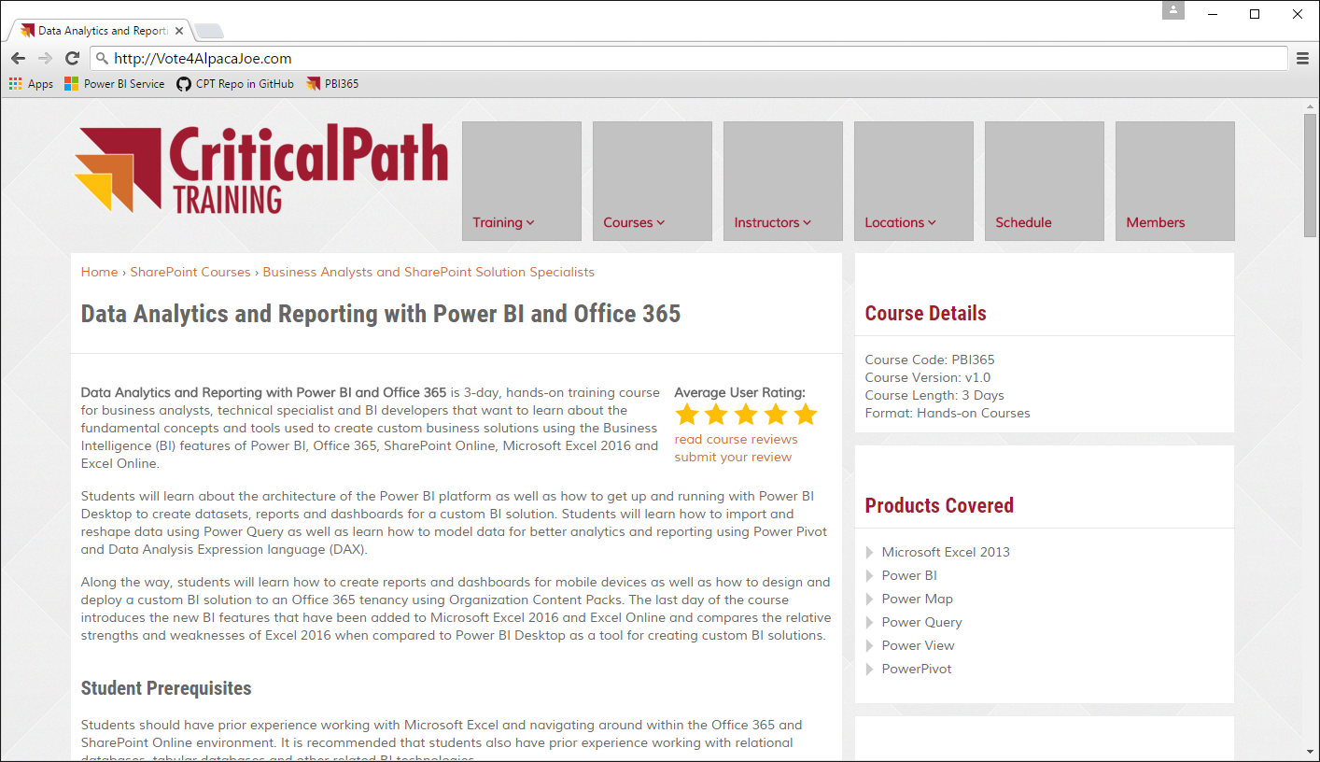

Real-time Scenario Being Simulated
Contribution website accepts contributions from donors
Website calls web service to process credit card transaction
Website calls to Power BI REST API to create & update dataset
Vote for Joe
Vote for Joe
He’ll back an alpaca
Back an Alpaca
Donate
Related Links
Privacy Policy
Credit Card Authority
Contributions
Web Site
Power BI Service
Copyright 2016 – Alpaca Joe’s Super Pac to Get Back to the Facts When a Jackass Attacks an Alpaca - All Right Reserved

Slide 24
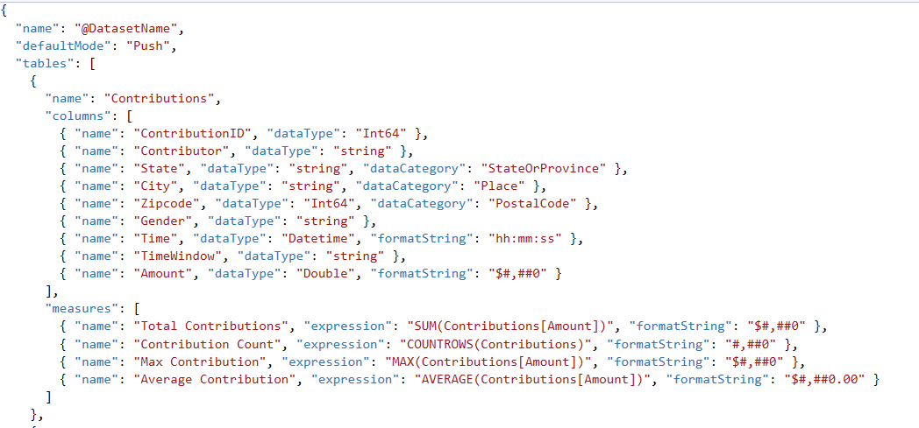
Creating a Push Dataset
Push dataset created using JSON schema definition
Push dataset can contain multiple tables and table relationships
Tables can contains measures as well as columns
Columns & measures can be defined with formatString & dataCategory

Slide 25
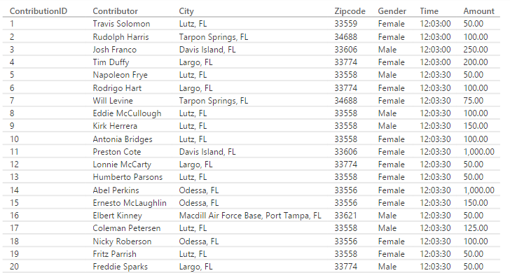
Creating a Tumbling Time Window

Slide 26
Designing a Real-time Dashboard using a Push Dataset

Slide 27
Real-time Dataset Matrix
Feature | Streaming | Hybrid | Push
Updates in real-time | Yes | Yes | Yes
Smooth animations | Yes | Yes | No
Backed by Azure SQL DB | No | Yes | Yes
Report Designer Support | No | Yes | Yes
Allow Rich Data Modeling | No | No | Yes
Ingestion Rate | 5 request/sec 15KB/request |  | 1 request/second 16MB/request

Slide 28
Scaling a Real-time Dashboard
Low velocity data scenario
High velocity data scenario
My App
Power BI Service
HTTP
Data Sender
Data Sender
HTTP
Azure
Event Hub
Azure
Streaming Analytics
Power BI
Service
Data Sender
Data Sender
Data Sender

Slide 29
Summary
Introduction to Real-time Datasets
Creating a Streaming Dataset with the API
Designing Dashboards with Streaming Data Tiles
Creating a Push Dataset with Real-time Data

